Slide 1
Introduction to Artificial Intelligence (AI)
Understanding the Basics of Intelligent Systems

Slide 2
What is Artificial Intelligence?
AI is the branch of computer science that aims to create machines that can mimic human intelligence.
It involves programming computers to process data, learn from experience, and make decisions.
Goal: Develop systems that can perceive, reason, learn, and act.

Slide 3
Brief History of AI
1950: Alan Turing proposes the Turing Test
1956: Term "Artificial Intelligence" coined at Dartmouth Conference
1960s-70s: Early AI programs (e.g., ELIZA)
1980s: Rise of expert systems
2000s-Present: Deep learning, robotics, and real-world applications

Slide 4
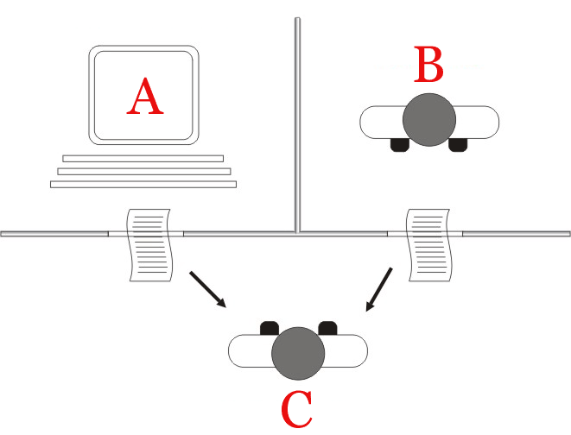
Turing Test
The Turing test refers to a thought experiment developed in 1950 by Alan Turing, a way to gauge a machine’s ability to generate human-like communication. Originally called “the imitation game,” the Turing test is a useful tool for studying a machine’s interactions with humans and reflecting on the definitions of “thinking” and “intelligence.”

Slide 5
Turing test participants
A Turing test has three participants:
A human judge (also called the interrogator) asks questions for a machine and a human to answer. The judge evaluates the responses from the machine and human to identify the responder.
A machine interlocutor, such as a generative AI system, answers the judge’s questions in natural language that simulates human conversation and behavior.
A human interlocutor who answers the judge’s questions alongside the machine and provides a baseline for comparison against the machine.

Slide 6
Types of AI
Narrow AI (ANI) – Weak AI:
Performs specific tasks (e.g., voice assistants)
General AI (AGI) – Strong AI:
Human-level intelligence (still theoretical)
Superintelligent AI - Future:
Beyond human capabilities (future concept)

Slide 7
Applications of AI
Voice Recognition (e.g., Siri, Alexa)
Image and Facial Recognition
Autonomous Vehicles
Healthcare Diagnosis
Financial Forecasting
Smart Assistants and Chatbots

Slide 8
Components of AI Systems
Learning: Acquiring knowledge from data
Reasoning: Drawing conclusions
Problem-Solving: Finding solutions to tasks
Perception: Understanding input (e.g., vision, sound)
Language Understanding: Processing human language

Slide 9
Searches in information System (IS)
information system, an integrated set of components for collecting, storing, and processing data and for providing information, knowledge, and digital products.
Examples:
1 - Transaction Processing System (TPS)
ATM systems, Point of Sale (POS) systems in retail, Online booking systems
2 - Management Information System (MIS)
Sales and inventory report system, HR management dashboards, Financial reporting systems
3 - E-commerce Systems
Amazon, Shopify, WooCommerce

Slide 10
Search Algorithms
In Artificial Intelligence (AI), searching algorithms are used to navigate through problem spaces (like mazes, puzzles, games, or decision trees) to find optimal solutions or paths.
Uninformed (Blind) Search Algorithms.
Informed (Heuristic) Search Algorithms

Slide 11
Uninformed (Blind) Search Algorithms.
These algorithms do not use any information about the goal other than how to generate successors.
Breadth-First Search (BFS)
Depth-First Search (DFS)
Uniform Cost Search (UCS)
Depth-Limited Search
Iterative Deepening DFS (IDDFS)

Slide 12
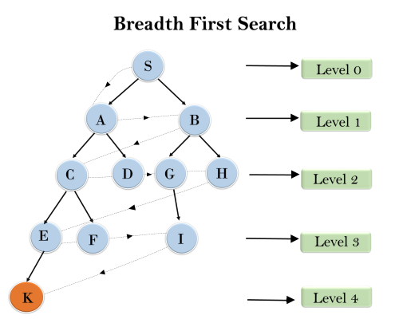
Breadth First Search (BFS)
S
AB
BCD
CDGH
DGHEF
GHEF
HEFI
EFI
FIK
IK
K

Slide 13
Intelligent Agents
An agent perceives its environment through sensors and acts upon it through actuators.
Goal: Choose actions that maximize performance.
Types: Simple reflex, model-based, goal-based, utility-based, learning agents

